Slide 1
OpenAPI Project
Abhishek Kumar
Dept. of Computer Science

Slide 2


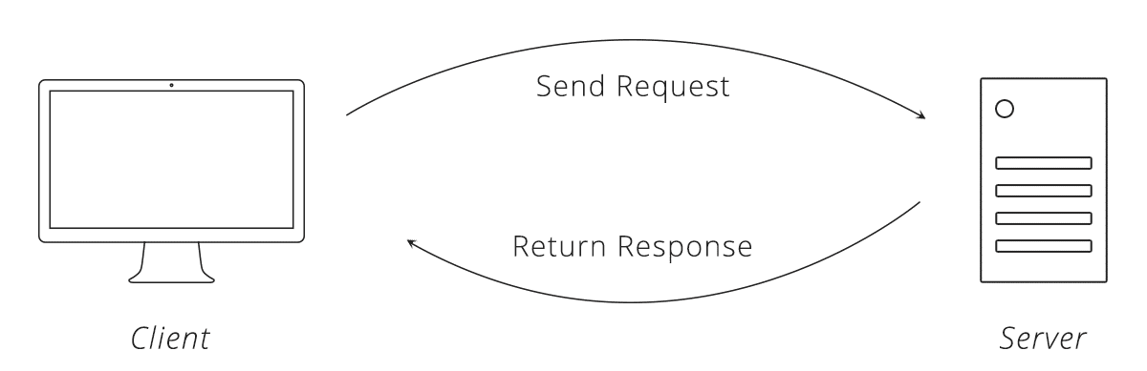
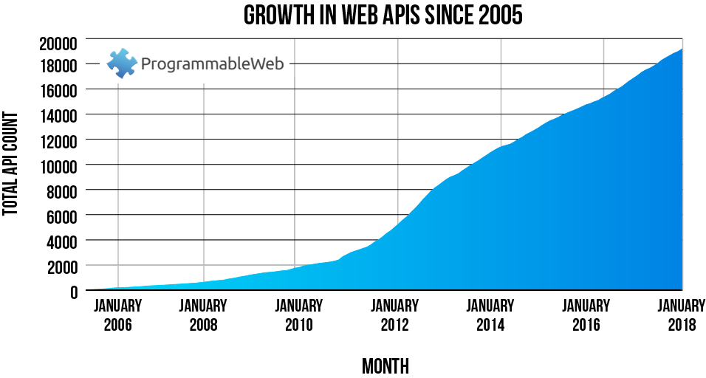
Introduction
Swagger and the Open API Specification are ways to define an API.
Application Programming Interface (API):
A UI to data and systems that is consumed by applications rather than humans.
It is a well defined contract between provider and consumer.
It defines how two pieces of software talk to each other.
How API request and response works? Not the full web-page, just the data.
API request: Send me the feed of my data.
API response: Transferring data that represents state of your feed.
Swagger and the Open API Specification are designed for REST APIs.
Swagger was a specification for how to create an API definition file.
After Swagger 2.0, the specification became the Open API Specification (OAS).
Swagger is now a collection of tools that use the Open API Specification.
The Open API Initiative (OAI) is an organization created by a consortium of industry experts.
Swagger Tools:
Swagger Editor: Helps you write OAS files
Swagger CodeGen: Generates code in popular languages for using your API
Swagger UI: Generates documentation from OAS files
SwaggerHub: Hosted platform for designing and documenting APIs

Slide 3
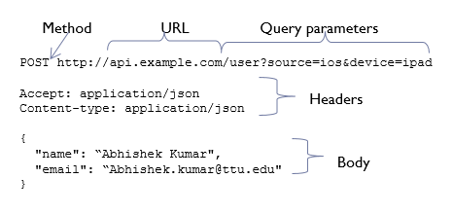
API Definition
API Definition File: A file that describes everything you can do with an API.
Server location
Authentication and authorization
All the available requests in that API
All the different data you can send in a request
What data is returned
What HTTP status codes can be returned
URL: https://api.example.com/v2/user
Scheme: https
Host: api.example.com
Base Path: /v2, Path: /user
The HTTP method describes what kind of action to take (GET, POST, PUT, DELETE, etc.)
Example: https://api.example.com/v2/user/{user-id}/connections?degrees=2
Path Parameters: {user-id}
Query Parameters: degrees
In REST, the response body can be anything, but is most often structured data, such as JSON
Security can be achieved using Basic Auth, API Key, OAuth.
Developers can provide sample requests and responses to create an OAS file

Slide 4

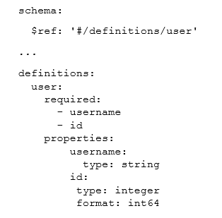
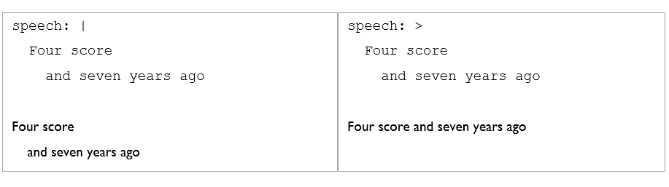
YAML
YAML stands for YAML Ain’t Markup Language.
The Open API Specification (OAS) uses structured data for its API definition files.
We can use one of two structured data formats: YAML or JSON.
Compared to JSON and XML, YAML minimizes characters. It's most often used for configuration files, rather than files passed over the web, like JSON.
We can use one of two structured data formats: YAML or JSON.
Lists: Use a dash to indicate a list item.
Multi-line strings: ‘|’ means preserve lines and spaces, ‘>’ means fold lines
Comments are denoted with the #. Everything after # is ignored.
OAS uses references for schemas. $ref is used to indicate a reference. We put the schema in a definitions section.
We can use one of two structured data formats: YAML or JSON.
XML
<name>
<firstName>Abhishek</firstName>
<lastName>Kumar</lastName>
</name>
YAML
name:
firstName: Abhishek
lastName: Kumar
JSON
name: {
"firstName": “Abhishek"
"lastName": “Kumar"
}

Slide 5
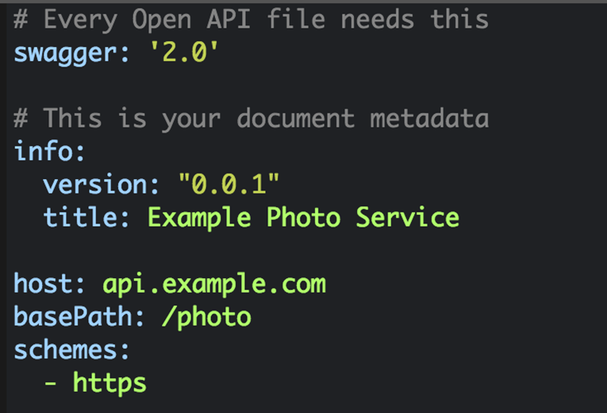
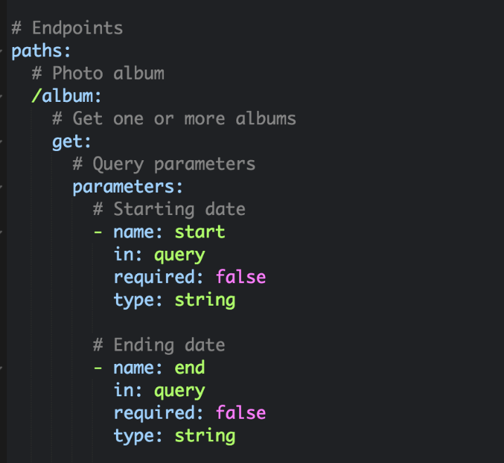
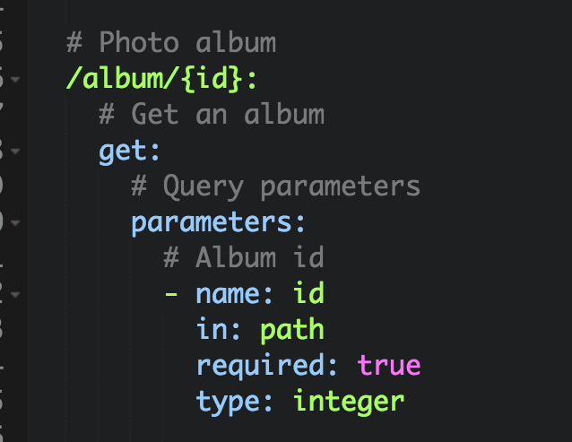
OpenAPI Specification Basics
Open API Specification File example: A service for uploading and sharing photos.
Company: example.com API base URL: https://api.example.com/photo
Requests will have: URL endpoint, HTTP Method, Path parameters, Query parameters
Example with query parameters:
GET https://api.example.com/photo/album?start=2017-09-01&end=2017-09-31
Example with path parameter:
GET https://api.example.com/photo/album/123456

Slide 6
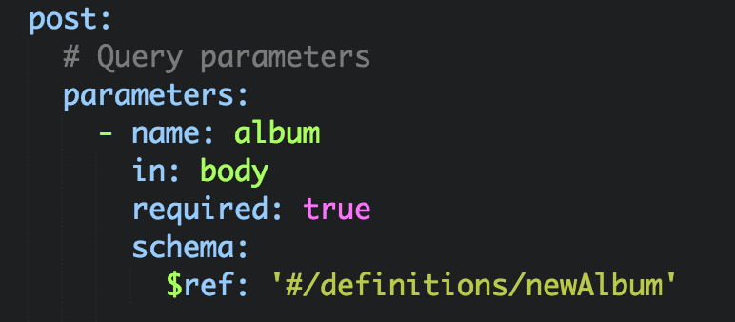
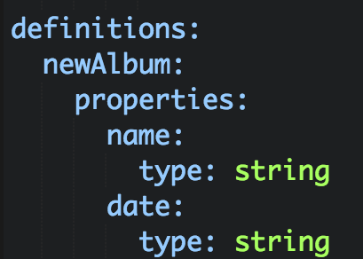
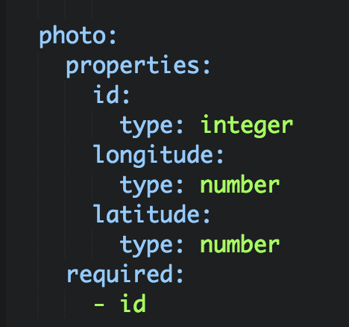
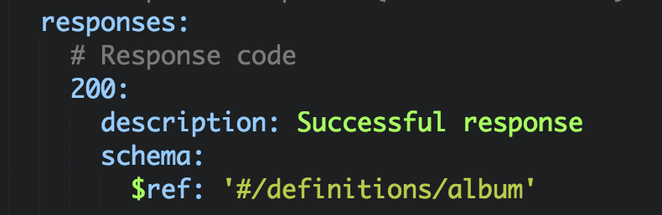
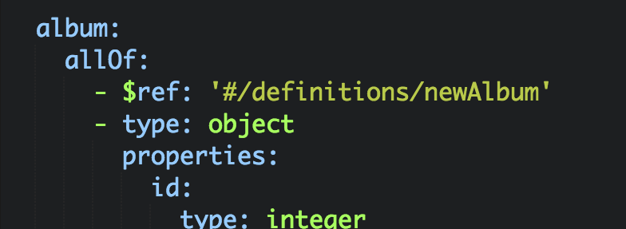
Schemas
The schema indicates the structure of the data.
$ref is a special OAS key that indicates that the value is a reference to a structure somewhere else in the YAML file.
Request Body: Under parameters: name – just for reference (not shown in docs) in – set to body required – typically set to true schema – - Add a level - Key of $ref - Value of the reference path, in quotes
Create a key called definitions at the end of the file.
Add a level and give it the name from the $ref value.
Add a properties key.
Add a type key that says what type of data it is.
In requests, you can specify that certain elements are required or optional.
Given below is the example of response body.
Can use the allOf key to combine several objects into one.

Slide 7

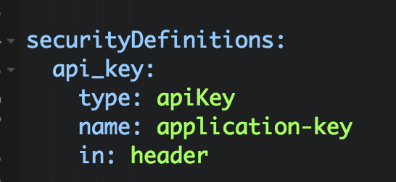
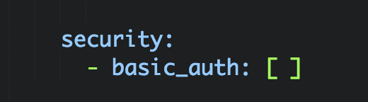
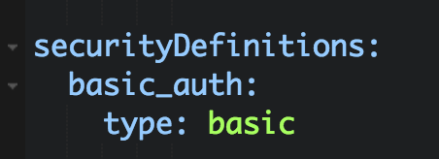
OpenAPI Specification Continued
Security means what kind of authentication or authorization is required.
Authentication: the user has correct username and password.
Authorization: the user has access to this API and data.
API key: Indicates that the app has permission to use the API.
Basic Authentication: Username and password is included in a header.
OAuth: Complex issuance of temporary token.
Security Definitions: The file contains a securityDefinitions key typically at the end.
API key example: Put a security key in the get section.
Errors are simply different response codes.
Example: 401 (Unauthorized) code returned {"errorCode": 13, "message": "Username not found"}
Content types indicate the format of the data in the request and response bodies. eExample: consumes for requests, produces for responses
Documentation:
Use the description key to add documentation – API Info, Operations. Parameters, Responses, Schema etc.

Slide 8
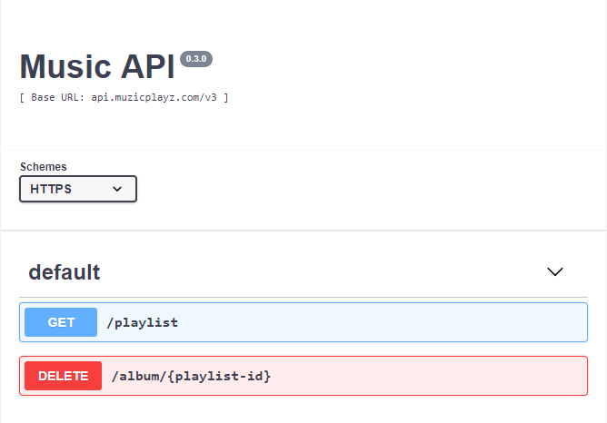
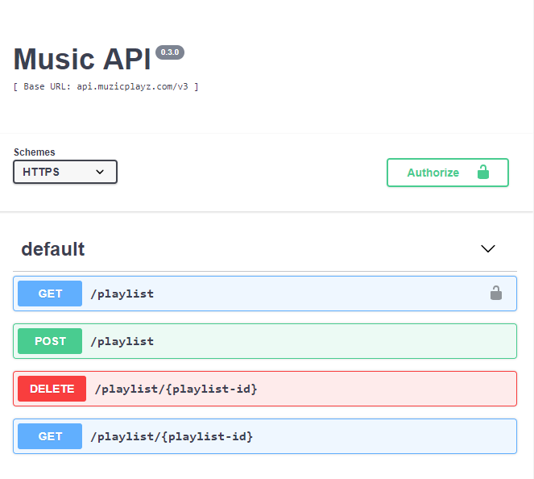
Swagger Editor
https://editor.swagger.io/
OpenAPI Specification Basics (version 1)
Click the following link to find the Open API file for a simple Music API
https://drive.google.com/open?id=13Cgc7us0nq-HAhoOnivGDQhaibEYqRMO
Schemas (version 2)
Click the following link to find the Open API file 2 for a simple Music API
https://drive.google.com/open?id=1awT7Kwm_1p7MysnB6QCL4ybo3t8dhGUf

Slide 9
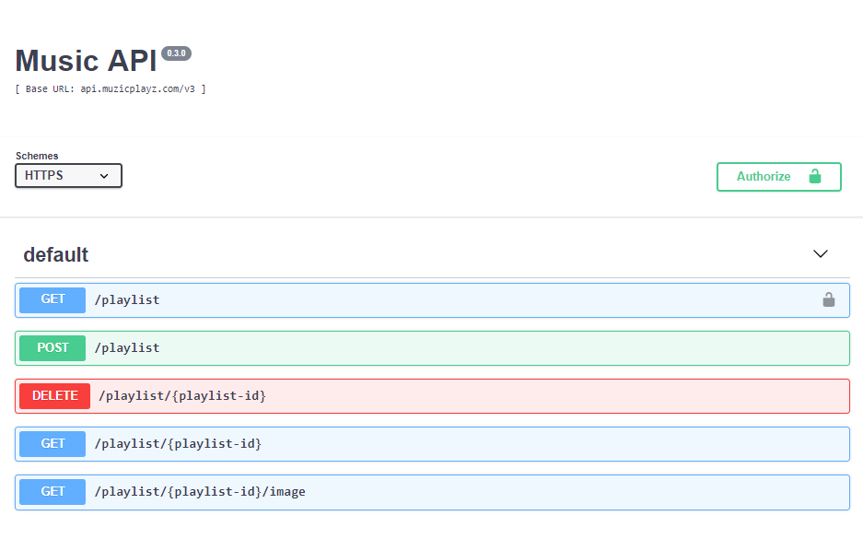
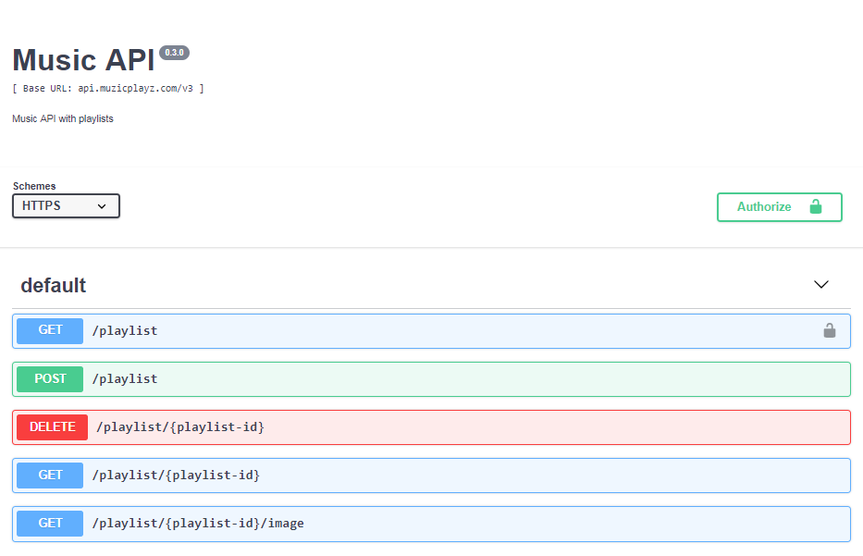
Swagger Editor
https://editor.swagger.io/
OpenAPI Specification Continued (version 3)
Click the following link to find the Open API file for a simple Music API
https://drive.google.com/open?id=10-7UbKNYFge0MaeQJcRX-OqUbCFX0NJV
Documentation (version 4)
Click the following link to find the Open API file for a simple Music API
https://drive.google.com/open?id=1C1B_y6In2YVcsrFBE7CqsMC0jRZ6uMaV

Slide 10
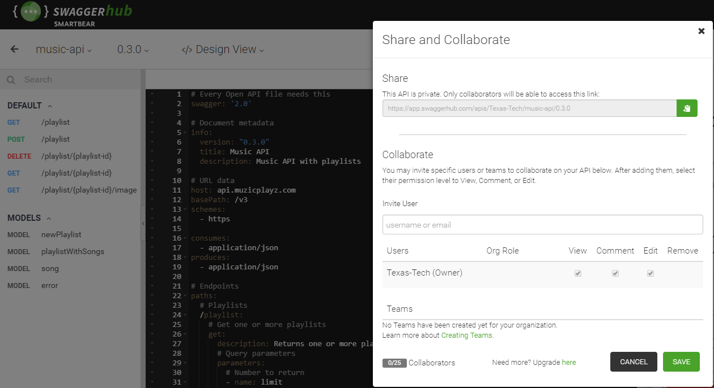
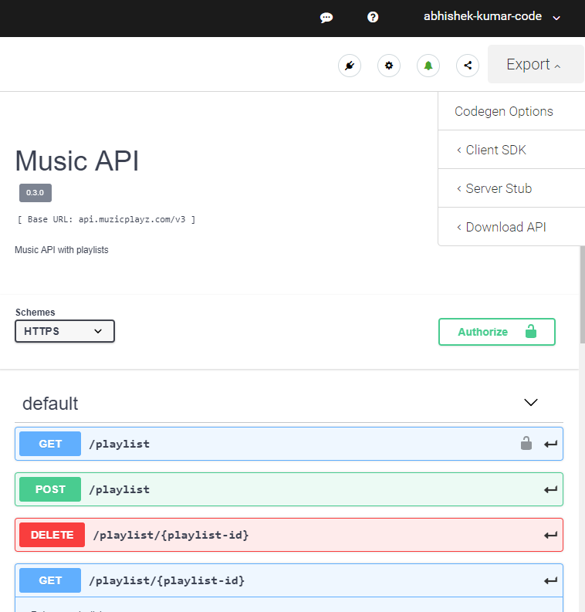
Swagger Hub
Provides all Swagger tools on a hosted platform.
Free for one user, $75month for a team of 5.
Advantages:
Don’t have to install and host.
Designed for collaboration.
Publishing is a way to show that the API is in a stable state and its endpoints can be reliably called from other applications.
SwaggerHub will generate the SDK to make it easy to call your API.

Slide 11


YAML vs JSON
In JSON, strings have quotes around them.
YAML indents are like JSON curly brackets { }
YAML lists are like JSON arrays [ ]
Advantages of YAML
Fewer characters
Easier to read
Swagger uses YAML as the default
Alternatives to Swagger
DapperDox
ReadMe.io
StopLight.io
Alternatives to OAS
RAML
API Blueprint
YAML
info:
version: "0.1.0"
title: Meme Meister
description: Meme API
JSON
{
"info":
{
"version": "0.1.0"
"title": "Meme Meister"
"description": "Meme API"
}
}

